Slide 1
UNIT 2 SCHOOL TALKS
PART C. LISTENING

Slide 2
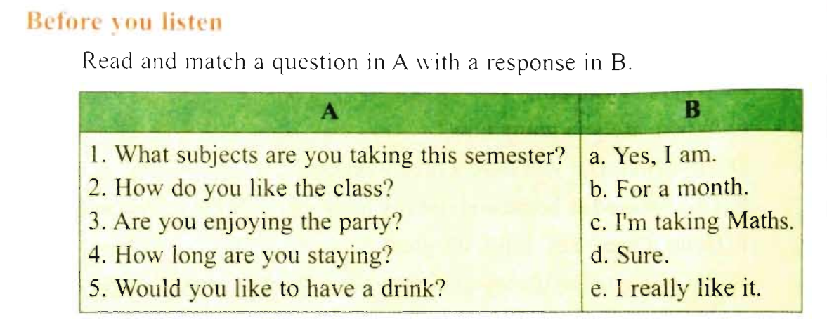
1 - c
2 - e
3 - a
4 - b
5 - d

Slide 3
VOCABULARY
semester
(n)
/səˈmestə/
one of the two periods of time that a year at high schools and universities is divided into
học kỳ
arrive
(v)
/əˈraɪv/
to get to a place, especially at the end of a journey
đến, tới
alone
(adj)
/əˈləʊn/
một mình, trơ trọi, đơn độc
without any other people
(adv)

Slide 4
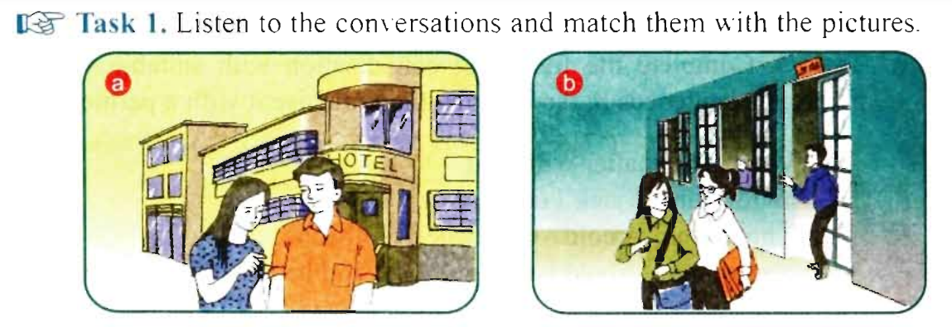
conversation 4
conversation 1
Conversation 2
conversation 3

Slide 5
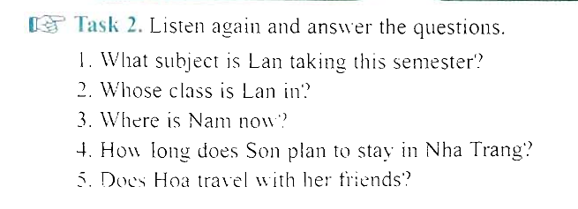

Slide 6
1. What subject is Lan taking this semester ?
⇨ She is taking English.
2. Whose class is Lan in ?
⇨ She’s in Miss Lan Phuong’s class.
3. Where is Nam now ?
⇨ He’s at a party.
4. How long does Son plan to stay in Nha Trang ?
⇨ He plans to stay there for a week.
5. Does Hoa travel with her friend ?
⇨ No, she doesn’t. (She travels alone)

Slide 7
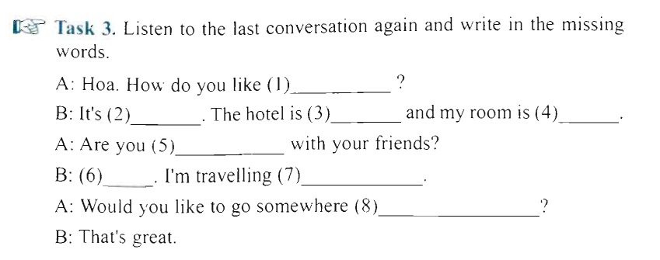
it here
very nice
big
comfortable
traveling
No
alone
for a drink

Slide 8
Clues:
Having exam stress.
Finding schoolwork difficult.
Having problems concentrating in class if others are noisy and disruptive.
Studying online

